Slide 1
CS258: Information Theory

Slide 2
Lecture 8: Model Comparison and Simulation
Model comparison
Occam’s Razor
Monte Carlo Methods

Slide 3

Occam’s Razor
How many boxes in the picture?
Intuition: Accept the simplest explanation that fits the data
A theory with mathematical beauty is more likely to be correct than an ugly one that fits some experimental data

Slide 4
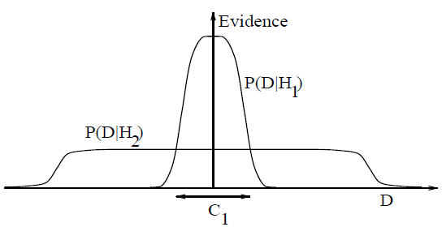

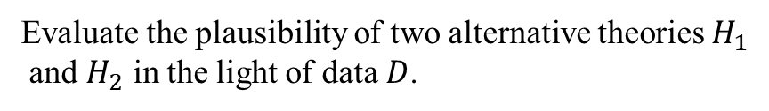
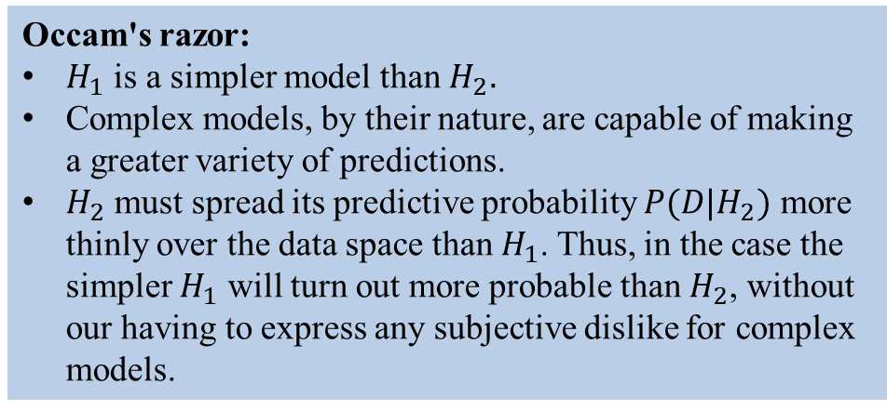
Model Comparison
Occam's razor:
$H_{1}$ is a simpler model than $H_{2}.$
Complex models, by their nature, are capable of making
a greater variety of predictions.
$H_{2}$ must spread its predictive probability $P(D|H_{2})$ more
thinly over the data space than $H_{1}$. Thus, in the case the
simpler $H_{1}$ will turn out more probable than $H_{2}$, without
our having to express any subjective dislike for complex
models.
Evaluate the plausibility of two alternative theories $H_{1}$
and $H_{2}$ in the light of data $D$.

Slide 5
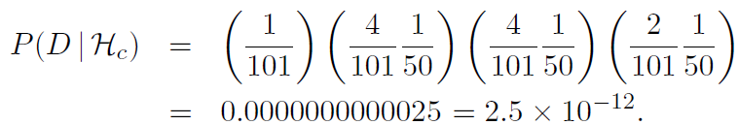
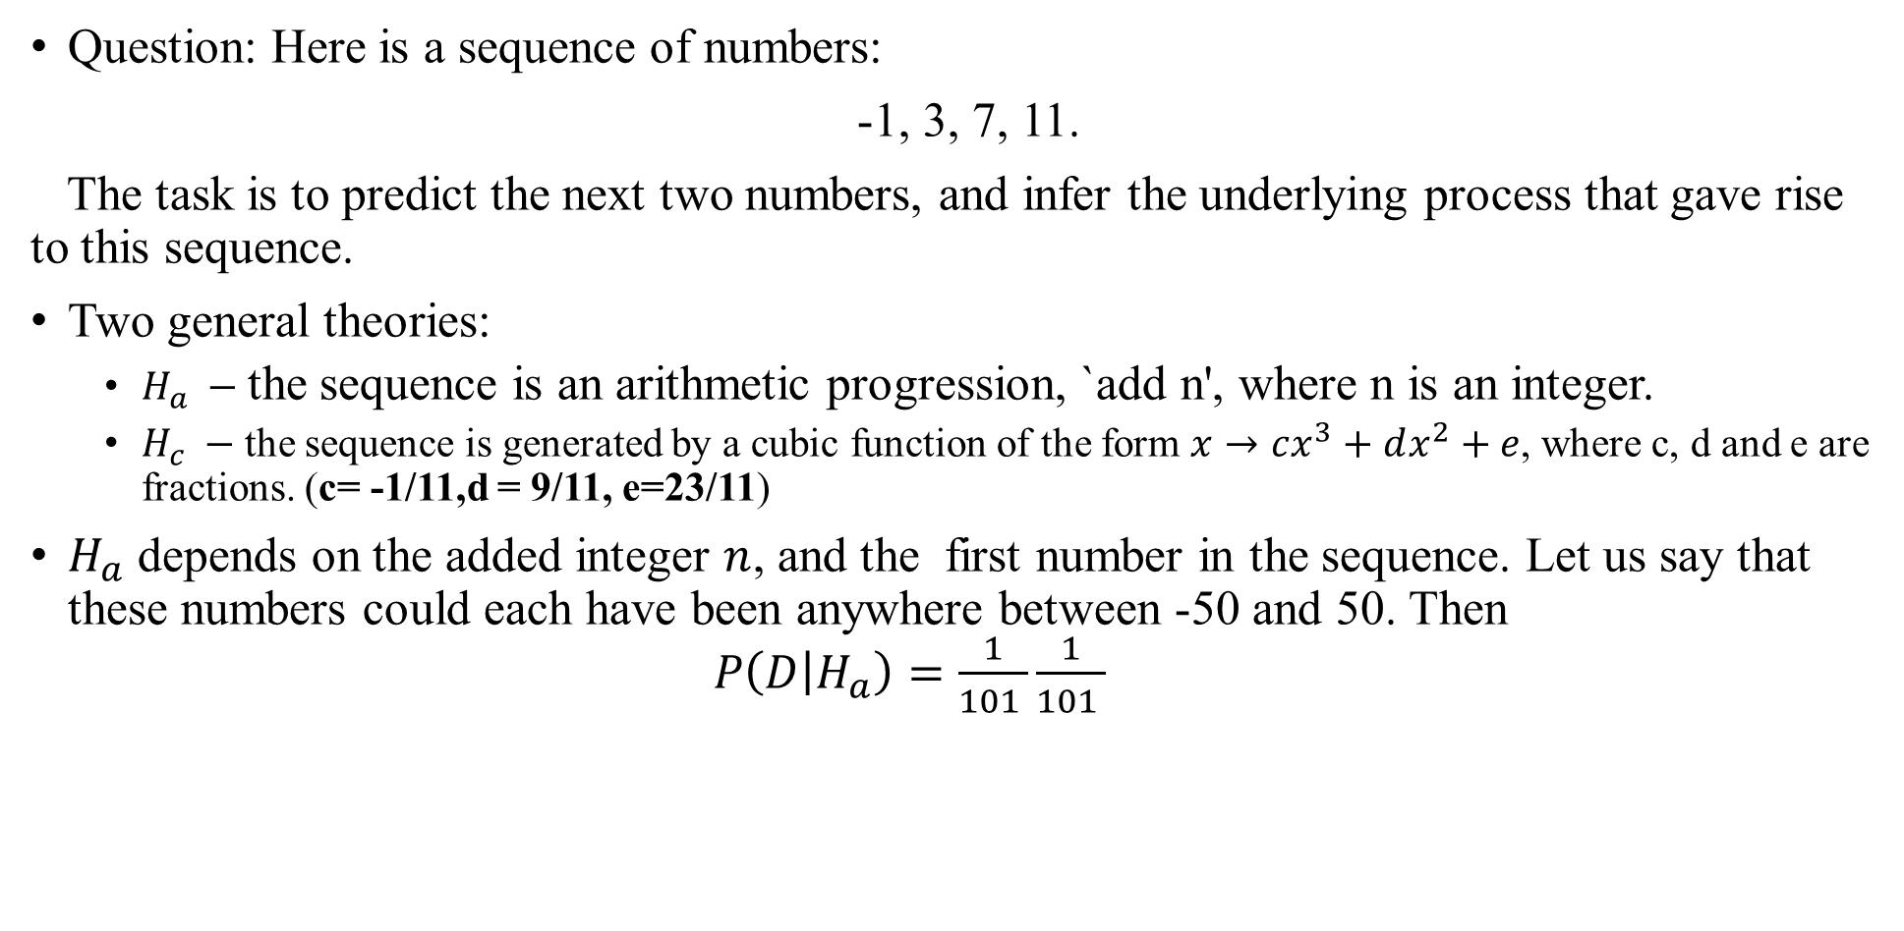
Occam’s Razor: An Example
Question: Here is a sequence of numbers:
-1, 3, 7, 11.
The task is to predict the next two numbers, and infer the underlying process that gave rise to this sequence.
Two general theories:
$H_{a} −$the sequence is an arithmetic progression, `add n', where n is an integer.
$H_{c} −$the sequence is generated by a cubic function of the form $x→cx^{3}+dx^{2}+e$, where c, d and e are fractions. (c= -1/11,d = 9/11, e=23/11)
$H_{a}$ depends on the added integer $n$, and the first number in the sequence. Let us say that these numbers could each have been anywhere between -50 and 50. Then $P\left(D | H_{a}\right)=\frac{1}{101 }\frac{1}{101 }$

Slide 6
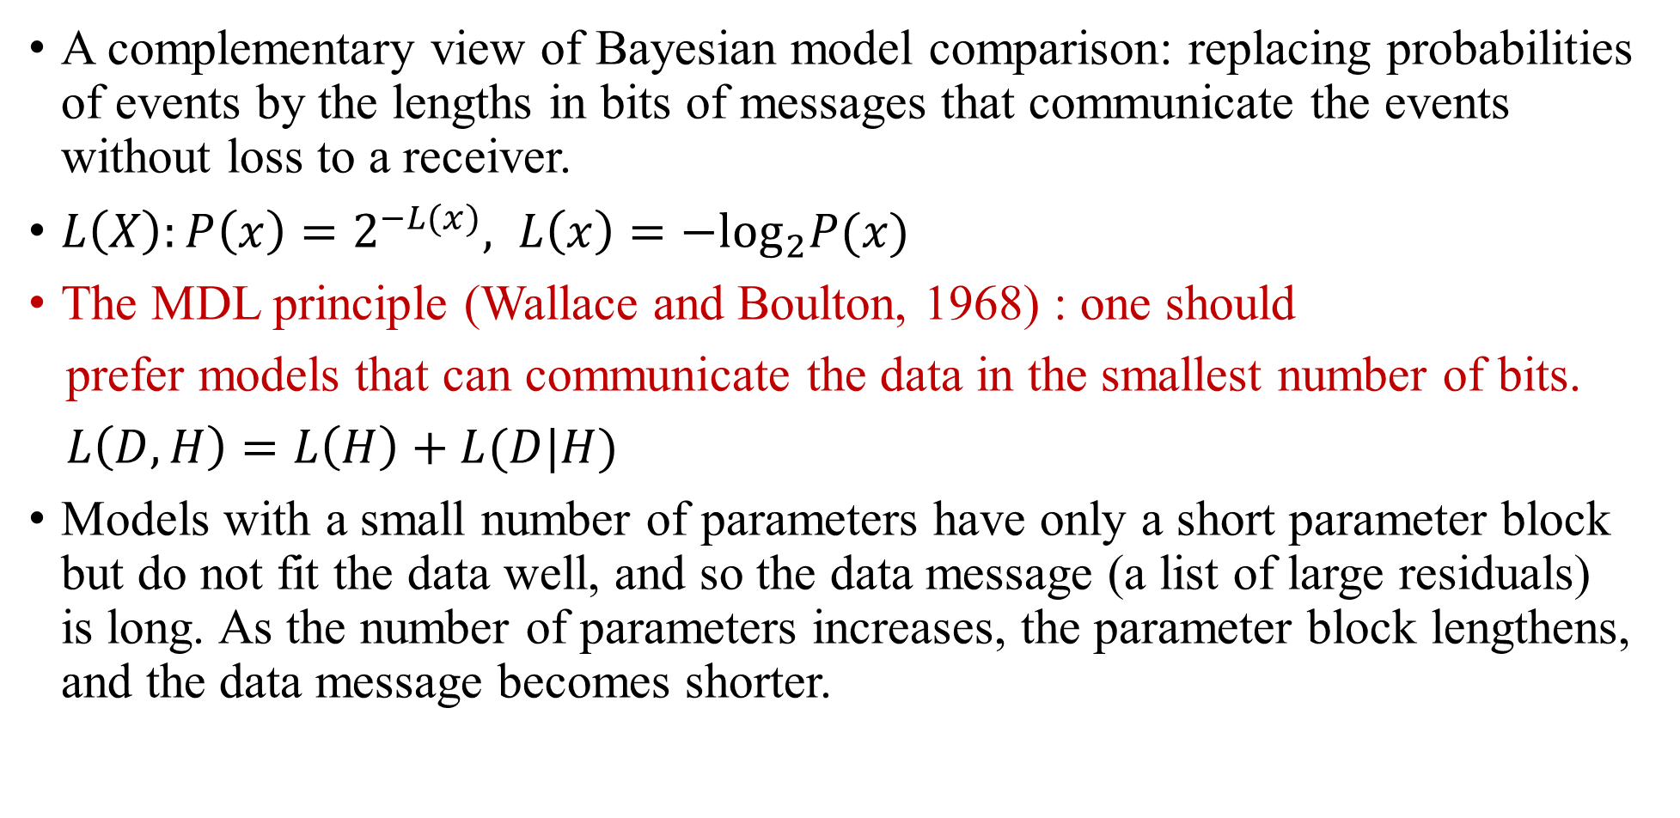
Minimum Description Length
A complementary view of Bayesian model comparison: replacing probabilities of events by the lengths in bits of messages that communicate the events without loss to a receiver.
$L\left(X\right):P\left(x\right)=2^{−L(x)}, L\left(x\right)=−\log_{2}P(x)$
The MDL principle (Wallace and Boulton, 1968) : one should
prefer models that can communicate the data in the smallest number of bits.
$L\left(D,H\right)=L\left(H\right)+L(D|H)$
Models with a small number of parameters have only a short parameter block but do not fit the data well, and so the data message (a list of large residuals) is long. As the number of parameters increases, the parameter block lengthens, and the data message becomes shorter.

Slide 7
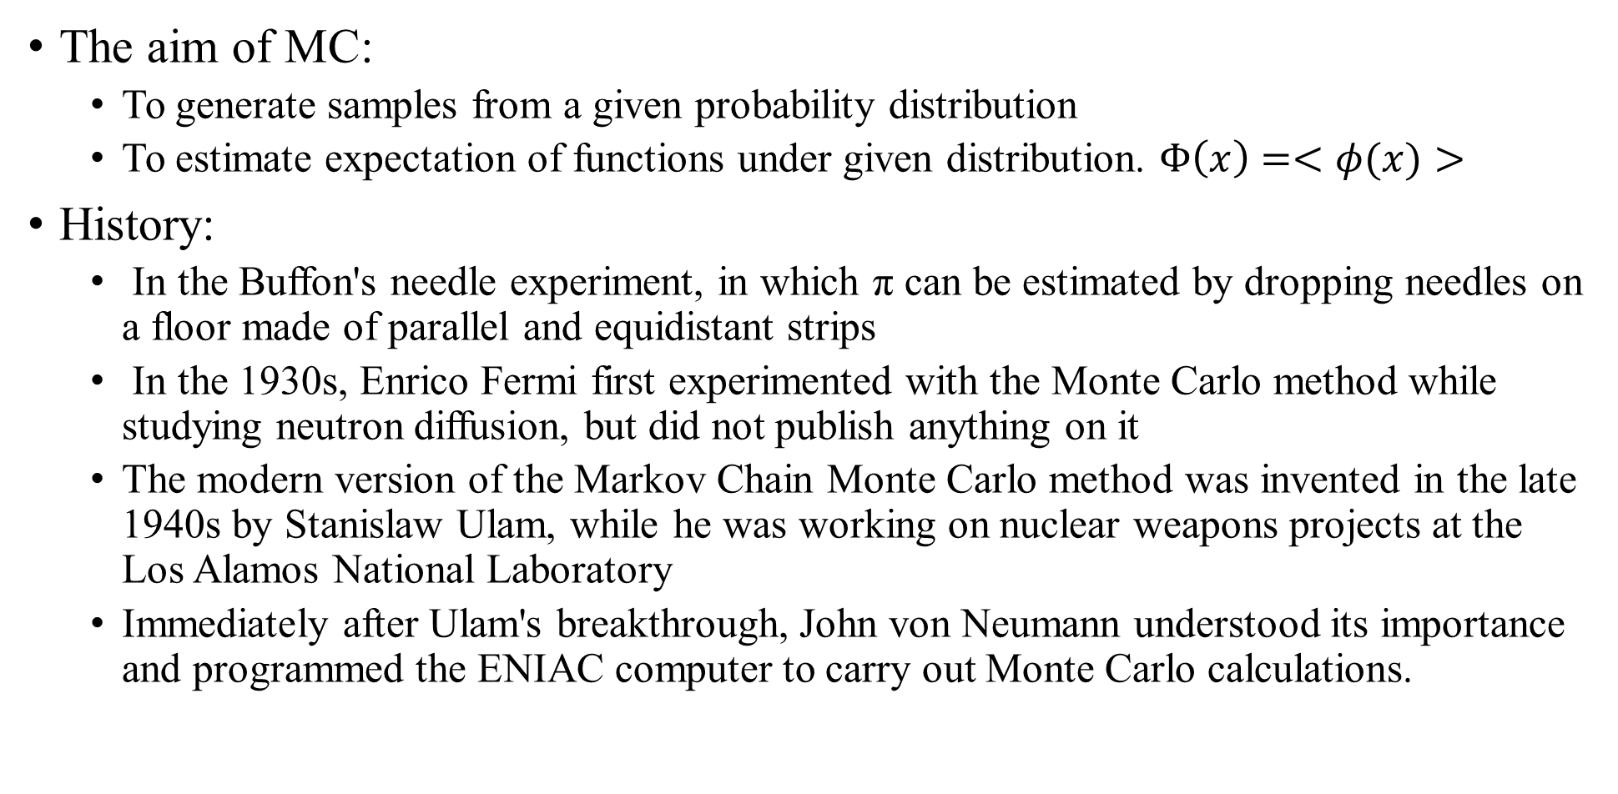
Monte Carlo Methods
The aim of MC:
To generate samples from a given probability distribution
To estimate expectation of functions under given distribution. $Φ\left(x\right)=<φ(x)>$
History:
In the Buffon's needle experiment, in which π can be estimated by dropping needles on a floor made of parallel and equidistant strips
In the 1930s, Enrico Fermi first experimented with the Monte Carlo method while studying neutron diffusion, but did not publish anything on it
The modern version of the Markov Chain Monte Carlo method was invented in the late 1940s by Stanislaw Ulam, while he was working on nuclear weapons projects at the Los Alamos National Laboratory
Immediately after Ulam's breakthrough, John von Neumann understood its importance and programmed the ENIAC computer to carry out Monte Carlo calculations.

Slide 8
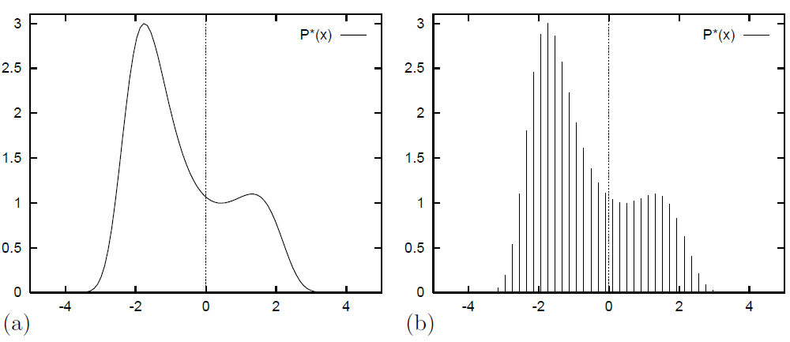

Life is hard
$$P\left(x\right)=exp⁡(0.4{\left(x−0.4\right)}^{2}−0.08x^{4})$$

Slide 9
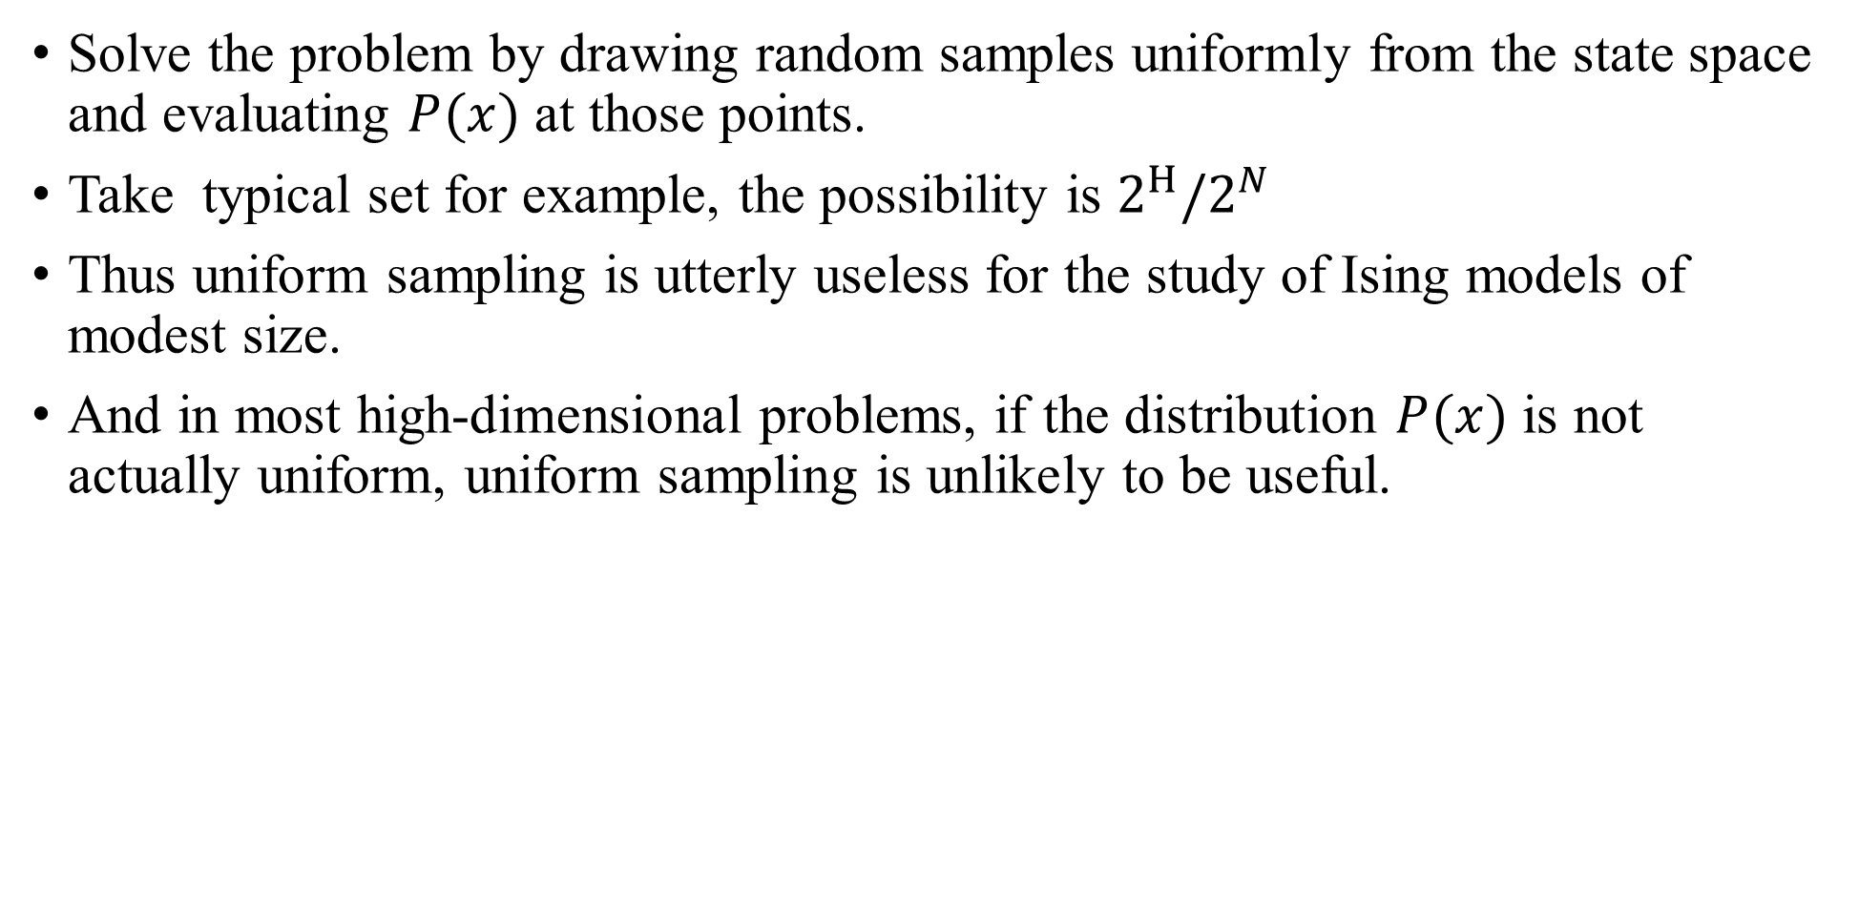
Uniform Sampling
Solve the problem by drawing random samples uniformly from the state space and evaluating $P(x)$ at those points.
Take typical set for example, the possibility is $2^{H}/2^{N}$
Thus uniform sampling is utterly useless for the study of Ising models of modest size.
And in most high-dimensional problems, if the distribution $P(x)$ is not actually uniform, uniform sampling is unlikely to be useful.

Slide 10


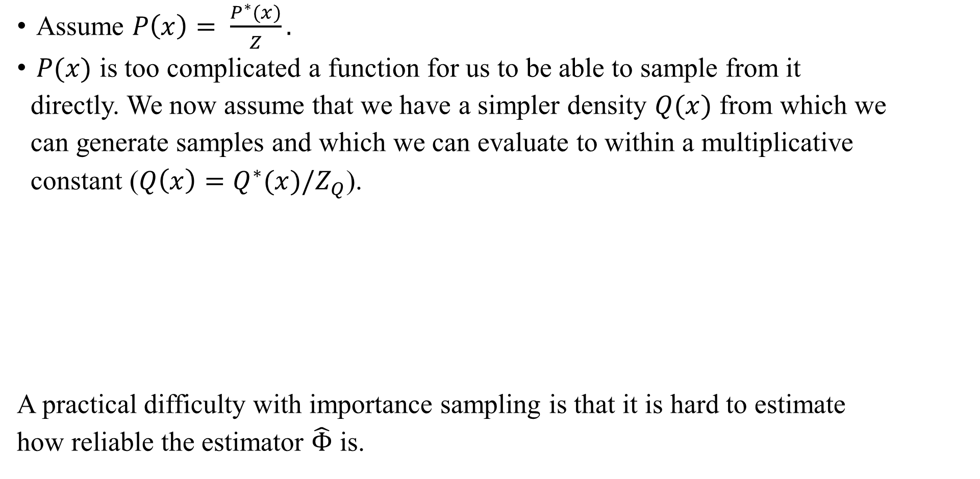
Importance Sampling
Assume $P\left(x\right)= \frac{P^{∗}(x)}{Z}.$
$P(x)$ is too complicated a function for us to be able to sample from it
directly. We now assume that we have a simpler density $Q(x)$ from which we
can generate samples and which we can evaluate to within a multiplicative
constant ($Q\left(x\right)=Q^{∗}(x)/Z_{Q}$).
A practical difficulty with importance sampling is that it is hard to estimate
how reliable the estimator $\hat{Φ}$ is.

Slide 11
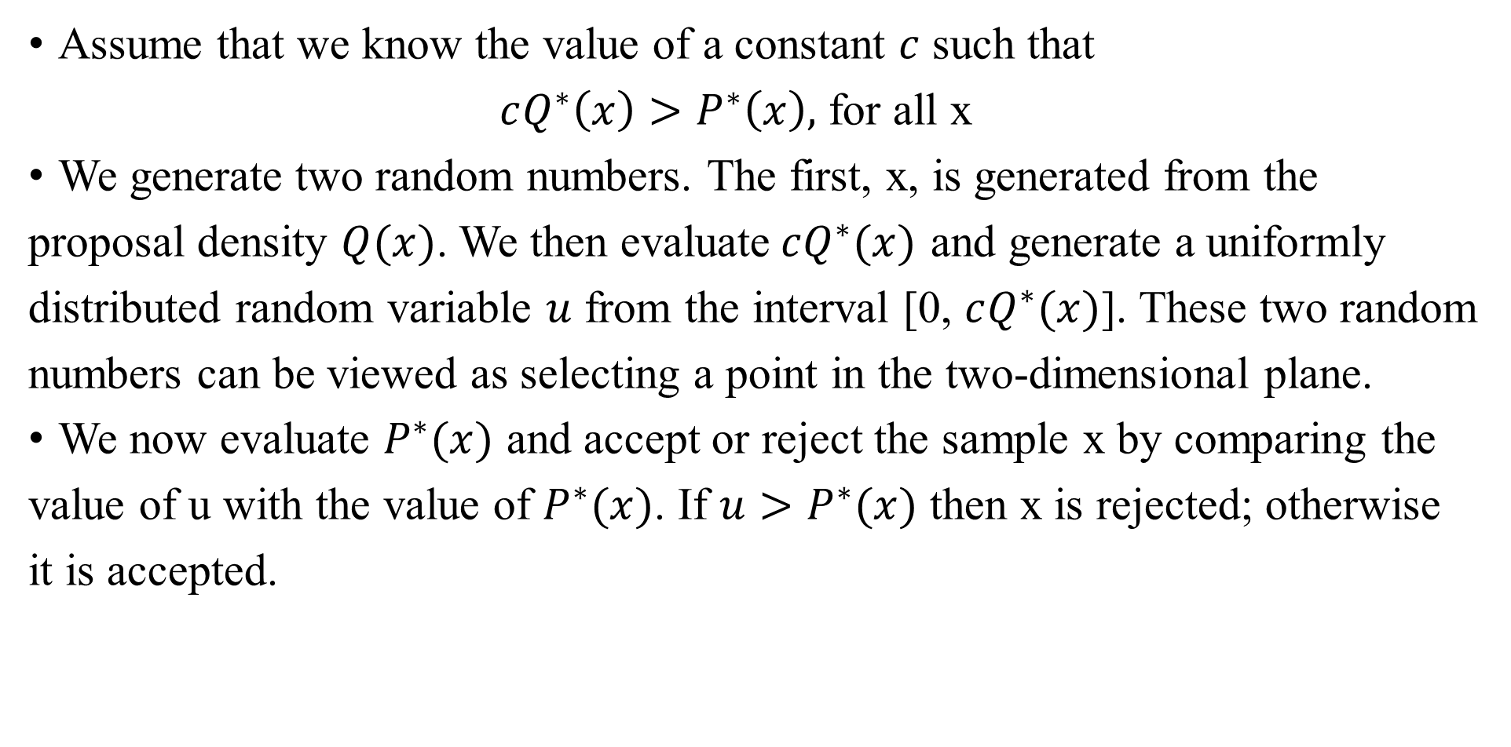
Rejection Sampling
Assume that we know the value of a constant $c$ such that
$cQ^{∗}\left(x\right)>P^{∗}\left(x\right),$ for all x
We generate two random numbers. The first, x, is generated from the
proposal density $Q(x)$. We then evaluate$cQ^{∗}(x)$ and generate a uniformly
distributed random variable $u$ from the interval [0, $cQ^{∗}(x)$]. These two random
numbers can be viewed as selecting a point in the two-dimensional plane.
We now evaluate $P^{∗}(x)$ and accept or reject the sample x by comparing the
value of u with the value of $P^{∗}(x)$. If $u>P^{∗}(x)$ then x is rejected; otherwise
it is accepted.

Slide 12
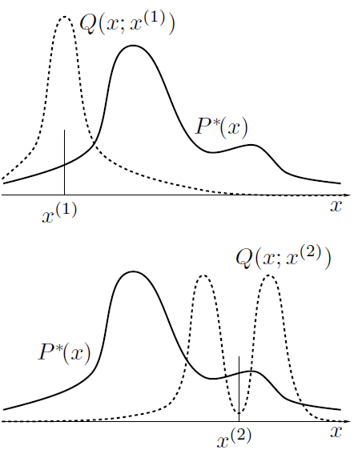
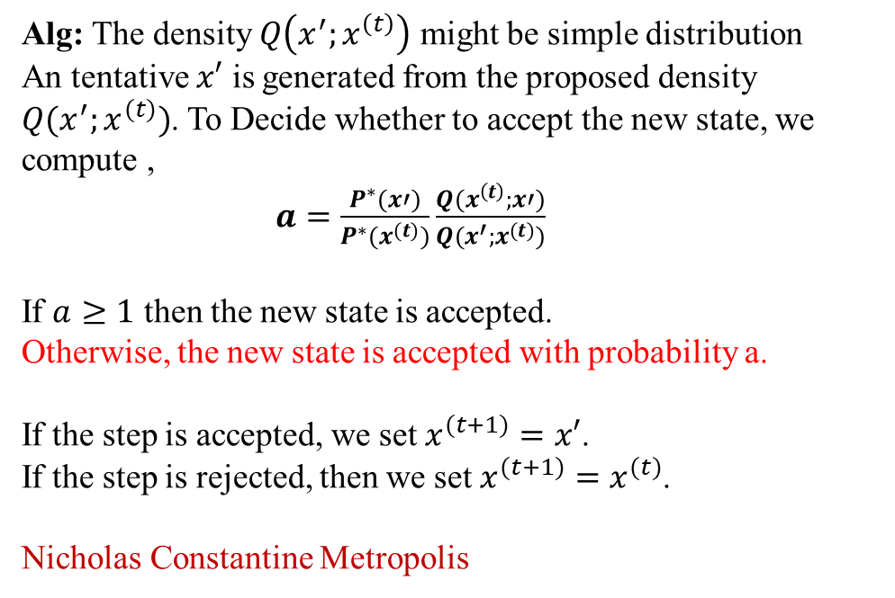
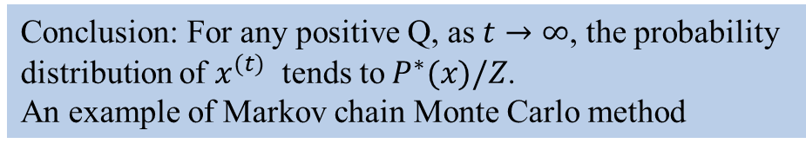
Metropolis-Hasting method
Alg: The density $Q\left(x^{′};x^{\left(t\right)}\right)$ might be simple distribution
An tentative $x′$ is generated from the proposed density
$Q(x^{′};x^{(t)})$. To Decide whether to accept the new state, we compute ,
$a=\frac{P^{∗}(x′)}{P^{∗}(x^{(t)})}\frac{Q(x^{\left(t\right)};x′)}{Q(x^{′};x^{(t)})}$
If $a≥1$ then the new state is accepted.
Otherwise, the new state is accepted with probability a.
If the step is accepted, we set $x^{(t+1)}=x′$.
If the step is rejected, then we set $x^{(t+1)}=x^{(t)}$.
Nicholas Constantine Metropolis
Conclusion: For any positive Q, as $t→∞$, the probability
distribution of $x^{(t)}$ tends to${ P}^{∗}(x)/Z$.
An example of Markov chain Monte Carlo method

Slide 13
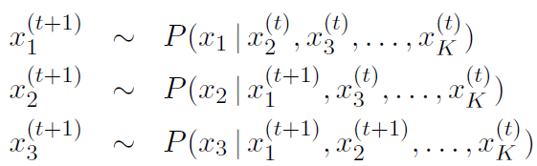
Gibbs Sampling
Gibbs sampling can be viewed as a Metropolis method in which a sequence of proposal distributions Q are defined in terms of the conditional distributions of the joint distribution P(x).

Slide 14
Reading
Ch. 28, Ch. 29
Exercise: 28.1, 28.2, 29.3, 29.4, 29.13

